Slide 1
ICU PROTOCOL
DR VINOD SRIVASTAVA
Associate Professor,
Department Anaesthesiology & critical care, KGMU

Slide 2
Protocol
Sedation and analgesia in ICU
Delirium assessment and control in ICU
Stress ulcer prophylaxis in ICU
Deep vein thrombosis prophylaxis in ICU
Glycaemic control in ICU

Slide 3
Pain , anxiety and delirium

Slide 4
Interaction of pain anxiety and delirium

Slide 5
Sedation And Analgesia In ICU
Goal of sedation and analgesia are “3c”= calm, comfortable and cooperative
Sedation are required for ICU patients to reduce anxiety and then consequently pain as well as delirium
To facilitate mechanical ventilation/ airway management and weaning and any intervention combinedly need sedation and analgesia
Decrease in anxiety leads to low incidence of delirium
Amnesia during neuromuscular blockade

Slide 6
Analgesia protocol in ICU
Pain: an unpleasant sensory or emotional experience.
Cause of pain in ICU patients: Intubated patients, suction, invasive procedure, bronchoscopy, multiple sampling, trauma and post surgical etc.
Describe in terms of intensity, duration, location and quality
Intensity is determinant factor for need of analgesia
Assesment :
Subjective: (Self report)
Objective (Behaviour observation)
Vitals : heart rate, blood pressure and RR.

Slide 7
Subjective assessment
Numerical ranking scale : valid and reliable assessment tool of conscious patient
Score form 0-10

Slide 8
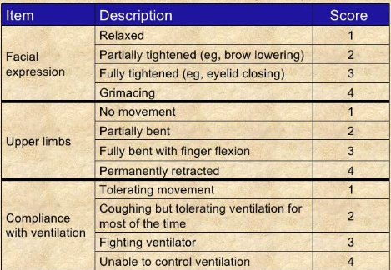
Objective assessment:
Behavioural pain scale
Valid and reliable assessment tool for intubated patients.
Range from minimum 3 (no pain ) to worst pain (12)

Slide 10
General guidelines for Analgesia
Analgesia is always given with sedation in ICU setting
Analgesia is covered earlier before sedation of patient to reduce incidence of delirium
Multi mode of analgesia can be used
Types of analgesia :
Intravenous :opioid and Non-opioids
Regional anaesthesia: Central neuraxial or peripheral
nerve block
Transdermal patch

Slide 11
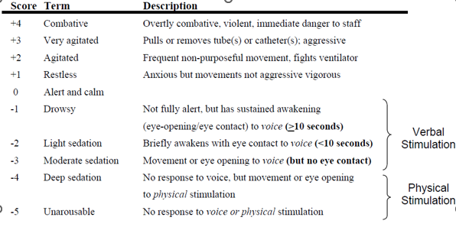
Scale used for assessment of sedation
Richmond Agitation Sedation Scale (RASS)

Slide 12
Procedure for RASS assessment

Slide 13
Drugs used for sedation
(A) Benzodiazepine group: Midazolam, lorazepam
(B) Non-Benzodiazepine group:
Propofol
Ketamine
Opioids
Dexmedetomidine

Slide 14
Benzodiazepines
DRUGS | LOADING DOSE | INFUSION | REMARK
Midazolam | 0.5 -4 mg | 0.02-0.1 mg/kg/hour | Liver metabolism Active metabolite through renal transmission Flumazenil antagonist
Lorazepam | 1-2 mg | 0.01-0.1 mg/kg/hour | Same as midazolam Propylene glycol toxicity with high dose infusion(hypotension,bradycardia,lactic acidosis,)

Slide 15
Non -Benzodiazepine
DRUGS | LOADING | INFUSION | REMARKS
Propofol | Not commonly used in ICU | 5-50 mcg/kg/min | For sedative purpose S/E propofol infusion syndrome
Dexmedetomidine | 1 mcg/kg over 10 minutes | 0.2 to 0.7 mcg/kg/hour | Used for sedation and analgesia Also anxiolytic
Ketamine | 0.25 to 0.5 mg/kg bolus IV | 0.05 to 0.4 mg/kg/hour | Sedation and analgesia Helps in Bronchodilation S/E Increased secretion
Fentanyl | 25–50 μg | 12.5–200 μg/h | Sedation and analgesia
Morphine | 2–4 mg | 2-30 mg/hr | Sedation and analgesia
Paracetamol | 15mg/kg in 15-20 min loading |  | Analgesia anti-inflammatory

Slide 16
General Guidelines for sedation and analgesia
1. Non benzodiazepine sedatives are preferred over benzodiazepine sedation to improve clinical outcomes of ICU patient on mechanical ventilation.
2. Assess Patients at regular interval (every 4 hours) for sedation and agitation based on the Sedation and Agitation scale. Worst score to be recorded within the last 4 hours.
3. Titrate the infusion rate of sedative medication with the aim of keeping the patient calm and co-operative.
4. In patients with head injury in view of cerebral protection deep sedation is required.
5. Routinely in ICU the drugs used for sedation are midazolam and fentanyl.
6. Propofol is preferable for patients where neurological status is of concern, and patient is for early weaning.

Slide 17
7. Postoperative patients who require overnight ventilation may be give sedation and analgesia using:
Fentanyl + propofol
dexmedetomidine
8. Daily sedation vacation is given at a fixed time every morning.
9. If patients are agitated, look for alternative cause of agitation. Communicate with patients, assure and increase the sedative dose if required.
10. Titrate the infusion rate according to sedation score at frequent interval by assessing the patient’s sedation score regularly.
11. Opioids and sedatives have a synergistic action. Lower doses of sedatives should be used if opioids or other sedatives are used.

Slide 18
Delirium In ICU
Delirium is an acute confusion state that is caused by direct physiological effects of some medical disease conditions, use of any psychoactive substances that develop over the course of hours and day.
In ICU delirium is non specific, preventable and reversible
Clinical syndrome: Common: Attention disorder
Lack of awareness
Cognitive impairment
Uncommon : Altered psychomotor activity
Disturbed circadian rhythm
Emotional disturbance and
Perception disorder like hallucination and delusion.

Slide 19
Etiology
Multifactorial . Predisposing and precipitating factor
Interaction of these two causes delirium
Predisposing Factor:: Nonmodifiable
Elderly patients (> 65 years)
Preexisting Cognitive impairment/dementia
Associated comorbidity like hearts disease, cerebrovascular disease, and cancer
Psychiatric morbidity (e.g., depression, bipolar disorder)
Sensory impairment (i.e., vision and hearing)

Slide 20
Precipitating factor: Modifiable
Medication (benzodiazepine, opioids, anticholinergic steroid)
Infection (e.g., URTI, UTI)
Hospital environment (dim light, noise in ward, unfamiliar person)
Hypoxia, hypercarbia and anemia
Dehydration/malnutrition
Inadequate analgesia
Stroke, meningitis
Sleep deprivation
Emotional stress
Constipation /urinary retention
Alcohol withdrawal
Major surgery (cardiac, vascular surgery

Slide 21
Screening of Delirium
Two tools are used:
Intensive care delirium screening checklist (ICDSC)
Confusion assessment method for ICU (CAM-ICU)

Slide 22
Intensive care delirium screening checklist (ICDSC)
It is assessed by 8 parameter:
Altered level of consciousness
Inattention
Disorientation
Hallucination, delusion or psychosis
Inappropriate mood or speech
Psychomotor agitation or retardation
Sleep wake cycle disturbance
Fluctuations
Each parameter is scored 0 to 1. Maximum score is 8 and minimum is zero.
Score of 4 is considered having delirium.
Sensitivity of 99% and specificity of 64%.
Not a good tool for stupor or comatose patient.

Slide 23
Confusion assessment method for ICU (CAM-ICU)
Most common and reliable method in ICU
4 Important features are key points for diagnosis of delirium.
Feature 1: Acute Onset or Fluctuating Course
Feature 2: Inattention
Feature 3: Altered Level of Consciousness
Feature 4: Disorganized Thinking

Slide 24
Confusion assessment method for ICU (CAM-ICU)

Slide 25
Treatment
Stop and THINK
Stop all medication if patient having that can precipitate like anticholinergic, corticosteroid, benzodiazepine, opioids etc.
THINK:
T= treat the toxic situation like CHF, Shock, dehydration,
H= treat for hypoxia, hypercarbia
I= treat infection and avoid immobilize (early mobilization)
N= non-pharmacological intervention
K= k+ or electrolyte correction

Slide 26
Non-Pharmacologic
Noise Reduction by use of earplugs for patients at night, reduce alarm volume.
Adequate light in ICU ward.
Communicate with patients and covey date, place and reason for hospitalization.
Avoid any type of stress.
Family interaction with patients.
Familiar belongings near the patient.
Improving sleep by sedation.
Reduce interruption at night.
Optimize bladder and bowel function.

Slide 27
Pharmacological
Haloperidol: short term use of low dose haloperidol at least for a week i
Atypical antipsychotics: use of this medication may reduce the duration of delirium (eg. risperidone, olanzapine, ziprasidone, and quetiapine )
The antidepressant trazodone is sometimes used for the same but effect should be weighed against its sedation side effect.
Dexmedetomidine should be practiced for sedation in place of benzodiazepine to reduce delirium.

Slide 28
Stress Ulcer Prophylaxis
Stress ulcer=Stress related mucosal disease (SRMD).
Ulceration of gastric mucosa of upper gastrointestinal (GI) tract due to hospitalization.
Ranges from common superficial mucosal injury, occult GI bleed, Hematemesis, to severe upper GI bleeding causing hemodynamic instability.
Mechanism : two mechanism responsible for
1. there are increased acid secretion
2. disruption of glycoprotein mucous layer

Slide 29
Risk factor for stress ulcer: patient with ≥2 are at greater risk
1.Prolonged mechanical ventilation for more than 48 hours.
2. Coagulation disturbance.
3. Shock.
4. Severe traumatic brain injury.
5. Burn > 30%.
6. Multi organ dysfunction syndrome (MODS).
7. Acute kidney injury.
8. Liver Failure.
9.History of gastrointestinal ulcers.
10.Glucocorticoid therapy.

Slide 30
Drugs used for prophylaxis
Proton pump inhibitor: IV pantoprazole 40mg OD
H₂ antagonist : Ranitidine 50 mg IV 8 hourly
Oral sucralfate: 1 gm every 6 hours

Slide 31
General guidelines for SMRD prophylaxis
Stop prophylactic therapy if patients does not have upper GI bleeding.
Switch over to oral medication as soon as patients start accepting oral feeding.
Those patients who develop clinically significant bleeding continue proton pump inhibitors for at least 2 weeks
Combination of prophylactic therapy along with enteral nutrition has been shown to reduce SRMD incidence.

Slide 32
Deep Venous Thrombosis Prophylaxis
DVT: Blood clot in deep vein
Most prevalent in critically ill patients
most commonly involved vein are pelvic ,thigh and leg and less commonly in arm

Slide 33
Sign and symptoms
The common symptoms are
Swelling
Erythema
Pain in affected part of body
Long standing complication are Ulceration
The most life threatening complication is Pulmonary embolism

Slide 34
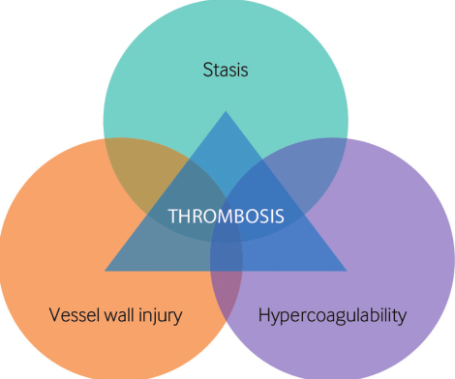
Pathophysiology of DVT
Virchow’s triad: three involved mechanism are
Decreased blood flow (venous stasis)
Endothelial injury
Hypercoagulability of blood

Slide 35
Risk factor for DVT
Old age
Prolonged immobilization
Major surgery
Previous DVT
Malignancy
Hormonal replacement therapy
Trauma and long bone fracture
Pregnancy and postpartum
Obesity
Elevated CVP due to heart failure
Coagulation disorders e.g., Polycythemia, thrombocytosis

Slide 36
DVT prophylaxis: General guidelines
Every patient in ICU should be assessed for requirement of DVT prophylaxis.
Non-pharmacological (mechanical) and pharmacological methods used as prophylactic.
Early ambulation is most crucial non pharmacologic method for prevention of VTE.
There is no advantage of combined pharmacologic and mechanical prophylaxis over pharmacological prophylaxis alone.
Thromboprophylaxis should be reviewed daily and changed accordingly.
Thromboprophylaxis should be continued even after transfer from ICU till the risk of DVT is over.

Slide 37
Methods for Prophylaxis
Mechanical prophylaxis: In patients of high risk bleeding such as post surgical, neurological, hemorrhagic and bleeding disorder
Graduated compression stockings.
Intermittent pneumatic compression.
Pharmacological prophylaxis:
Unfractionated heparin.
Low Molecular Weight Heparin (LMWH)
Fondaparinux.

Slide 38
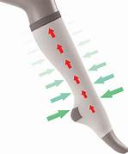
Graduated compression stocking (anti-embolic stockings)
Greatest degree of pressure at the ankle and gradually decreases when goes upwards (graduated compression)
Prevents backflow
Avoid in peripheral neuropathy, allergy to material, local soft tissue infection, improper size.

Slide 39
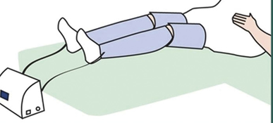
Intermittent pneumatic compression
Inflatable sleeves attach through a air pump
Inflate every 20-60 seconds then deflate, starting at ankle and goes upward
act as leg massage
More effective than GCS

Slide 40
Pharmacological prophylaxis
It should be started as soon as possible if not contraindicated.
Started once risk of bleeding is excluded after 24-72 hours depending upon the surgery and hemostasis achieved.
Unfractionated or Low Molecular Weight Heparin (LMWH) should be avoided in patients with platelet counts less than 1,00,000/L or INR >1.5.
LMWH should be stopped 12 hours before removal of epidural catheter and can be restarted only after 2 hours after removing it.

Slide 41
LMWH preferred to unfractionated heparin
Once daily dosing,
Enhanced bioavailability,
Minimal incidence of heparin-induced thrombocytopenia
Cost benefit
No requirement for laboratory monitoring.

Slide 42
Recommended dose of anticoagulant as prophylaxis
UFH- 5000 units SC 8-12 hourly
Enoxaparin- 30 mg 12-24 hourly or 40 mg once a day SC
Daltaparin – 5000-10000 units 12 hourly SC
Fondaparinux – 5-10 mg daily SC

Slide 43
Risk of bleeding
Mechanical
Prophylaxis
Pharmacological
Prophylaxis
Unfractionated heparin and LMWH
Graded compression stockings
Yes
Asses for risk of DVT
Yes
Intermittent Pneumatic compression device
Heparinoids: Fondaaparinux
No
HIT?
No
Yes

Slide 44
Glycemic control in ICU
Hyperglycemia is strongly associated with increased mortality as well as organ system dysfunction among critically ill patients
Goal: Maintain the glucose level 140-180 mg/dl.
But hypoglycaemia and intensive glycaemic control were associated with adverse outcomes

Slide 45
Why hperglycemia in critically ill patients
Increased counter regulatory hormones (glucagon ,cortisol)
Insulin resistance
Decrease insulin stimulated uptake of glucose in tissue
Glucocorticoid therapy
Dextrose containing solution and TPN

Slide 46
Monitoring in ICU
Blood testing by finger testing
Diet | Frequency of monitoring
NPO | 8 hourly
PO | 1 hour before feed and 6 hourly
TPN | 6 hourly . 6 Am, noon, 6PM,midnight

Slide 47
Treatment of hyperglycemia
Glucose level (mg/dl) | Action (subcutaneous insulin dose)
<140 | No treatment
140-169 | 3 unit of regular insulin, recheck after 3 hour
170-199 | 4 unit of regular insulin, recheck after 3 hour
200-249 | 6 unit of regular insulin, recheck after 3 hour
250-299 | 8 unit of regular insulin, recheck after 3 hour
>300 | 10 unit of regular insulin, recheck after 3 hour

Slide 48
Insulin infusion
If glucose value excceds 200 on two measurement, a continuous insulin infusion started.
Must receive continuous source of glucose either D5 or TPN, enteric feed
Hourly glucose charting
Glucose value (mg/dl) | Insulin dose
200-249 | 4 U/hour
250-299 | 6 U/hour
300-399 | 8 U/hour
≥ 400 | 10 U/hour

Slide 49
Subsequent management
Glucose value (mg/dl) | Action (Insulin dose )
<140 | Stop infusion
140-169 | 2 Unit/hour
170-199 | 3 Unit/hour
200-349 | 6 Unit/hour
350-399 | 8 Unit/hour
≥400 | 10 Unit/hour

